Slide 1
UNIT – I BASICS OF CELL

Slide 2
A cell is defined as the smallest, basic unit of life that is responsible for all of life’s processes.Cells are the structural, functional, and biological units of all living beings. A cell can replicate itself independently. Hence, they are known as the building blocks of life. Each cell contains a fluid called the cytoplasm, which is enclosed by a membrane. Also present in the cytoplasm are several biomolecules like proteins, nucleic acids and lipids. Moreover, cellular structures called cell organelles are suspended in the cytoplasm.A cell is the structural and fundamental unit of life. The study of cells from its basic structure to the functions of every cell organelle is called Cell Biology. Robert Hooke was the first Biologist who discovered cells .All organisms are made up of cells. They may be made up of a single cell (unicellular), or many cells (multicellular). Mycoplasmas are the smallest known cells. Cells are the building blocks of all living beings. They provide structure to the body and convert the nutrients taken from the food into energy .Cells comprise several cell organelles that perform specialised functions to carry out life processes. Every organelle has a specific structure. The hereditary material of the organisms is also present in the cells
CELL DISCOVERY
Robert Hooke discovered the cell in 1665. Robert Hooke observed a piece of bottle cork under a compound microscope and noticed minuscule structures that reminded him of small rooms. Consequently, he named these “rooms” as cells. However, his compound microscope had limited magnification, and hence, he could not see any details in the structure. Owing to this limitation, Hooke concluded that these were non-living entities. Later Anton Van Leeuwenhoek observed cells under another compound microscope with higher magnification. This time, he had noted that the cells exhibited some form of movement (motility). As a result, Leeuwenhoek concluded that these microscopic entities were “alive.” Eventually, after a host of other observations, these entities were named as animalcules.

Slide 3
Characteristics of cell
Cells provide structure and support to the body of an organism.
• The cell interior is organised into different individual organelles surrounded by a separate membrane.
• The nucleus (major organelle) holds genetic information necessary for reproduction and cell growth.
• Every cell has one nucleus and membrane-bound organelles in the cytoplasm.
• Mitochondria, a double membrane-bound organelle is mainly responsible for the energy transactions vital for the survival of the cell.
• Lysosomes digest unwanted materials in the cell.
• Endoplasmic reticulum plays a significant role in the internal organisation of the cell by synthesising selective molecules and processing, directing and sorting them to their appropriate locations
PROKARYOTIC CELLS
Prokaryotic cells have no nucleus. Instead, some prokaryotes such as bacteria have a region within the cell where the genetic material is freely suspended. This region is called the nucleoid.
• They all are single-celled microorganisms. Examples include archaea, bacteria, and cyanobacteria.
• The cell size ranges from 0.1 to 0.5 µm in diameter.
• The hereditary material can either be DNA or RNA.Prokaryotes generally reproduce by binary fission, a form of asexual reproduction.
• They are also known to use conjugation – which is often seen as the prokaryotic equivalent to sexual reproduction (however, it is NOT sexual reproduction

Slide 4
EUKARYOTIC CELLS
Eukaryotic cells are characterised by a true nucleus.
• The size of the cells ranges between 10–100 µm in diameter.
• This broad category involves plants, fungi, protozoans, and animals.
The plasma membrane is responsible for monitoring the transport of nutrients and electrolytes in and out of the cells. It is also responsible for cell to cell communication.
• They reproduce sexually as well as asexually.
• There are some contrasting features between plant and animal cells. For eg., the plant cell contains chloroplast, central vacuoles, and other plastids, whereas the animal cells do not.

Slide 5
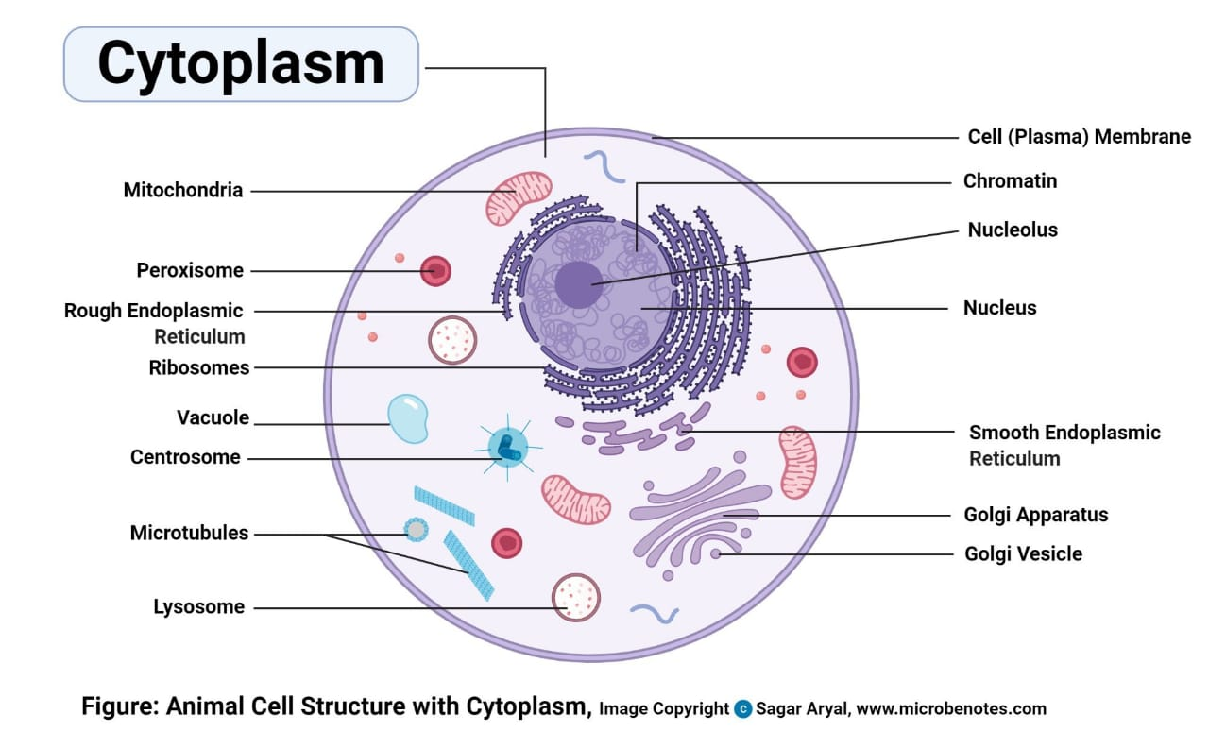
DIAGRAM OF ANIMAL CELL AND PLANT CELL

Slide 6
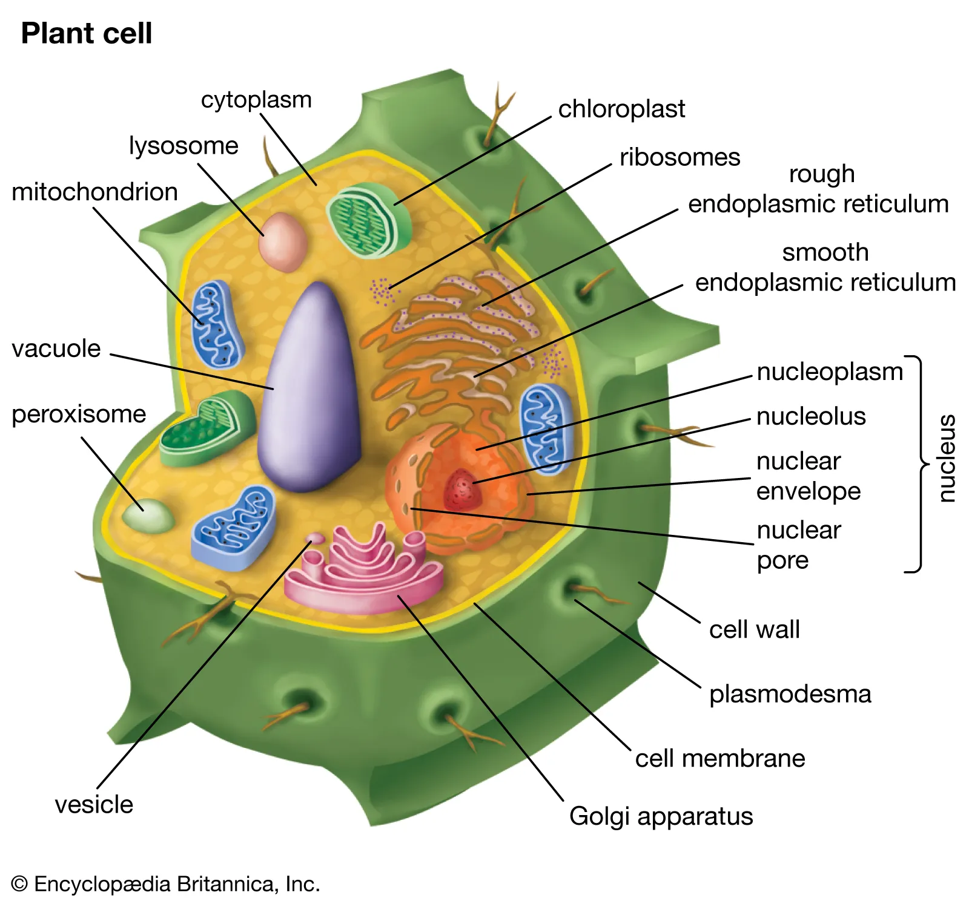

Slide 7
DIFFERENCE BETWEEN ANIMAL AND PLANT CELL
CHARACTERISTICS | Animal cell | Plant cell
size | 10-30 micrometer | 10-100micrometer
shape | irregular | regular
Cell wall | absent | present
nucleus | centre | Off centre
Stored energy | glycogen | starch
lysosome | present | Rarely present
Chloroplast | absent | present

Slide 8
Cell structure
The cell structure comprises individual components with specific functions essential to carry out life’s processes. These components include- cell wall, cell membrane, cytoplasm, nucleus, and cell organelles. Read on to explore more insights on cell structure and function.
Cell Membrane
The cell membrane supports and protects the cell. It controls the movement of substances in and out of the cells. It separates the cell from the external environment. The cell membrane is present in all the cells. The cell membrane is the outer covering of a cell within which all other organelles, such as the cytoplasm and nucleus, are enclosed. It is also referred to as the plasma membrane. By structure, it is a porous membrane (with pores) which permits the movement of selective substances in and out of the cell. Besides this, the cell membrane also protects the cellular component from damage and leakage.
It forms the wall-like structure between two cells as well as between the cell and its surroundings. Plants are immobile, so their cell structures are well-adapted to protect them from external factors. The cell wall helps to reinforce this function

Slide 9
Cell Wall
The cell wall is the most prominent part of the plant’s cell structure. It is made up of cellulose, hemicellulose and pectin. The cell wall is present exclusively in plant cells. It protects the plasma membrane and other cellular components. The cell wall is also the outermost layer of plant cells. It is a rigid and stiff structure surrounding the cell membrane. It provides shape and support to the cells and protects them from mechanical shocks and injuries.
Cytoplasm
The cytoplasm is a thick, clear, jelly-like substance present inside the cell membrane. Most of the chemical reactions within a cell take place in this cytoplasm. The cell organelles such as endoplasmic reticulum, vacuoles, mitochondria, ribosomes, are suspended in this cytoplasm.
Nucleus
The nucleus contains the hereditary material of the cell, the DNA. It sends signals to the cells to grow, mature, divide and die. The nucleus is surrounded by the nuclear envelope that separates the DNA from the rest of the cell. The nucleus protects the DNA and is an integral component of a plant’s cell structure.

Slide 10
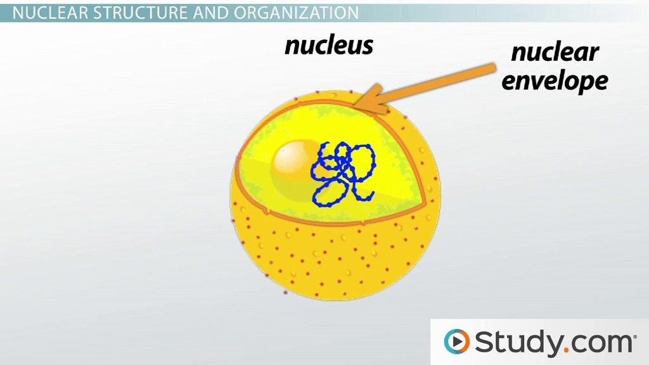
CELL ORGANELLES
Cells are composed of various cell organelles that perform certain specific functions to carry out life’s processes. The different cell organelles, along with its principal functions, are as follows:
1.Nucleolus
The nucleolus is the site of ribosome synthesis. Also, it is involved in controlling cellular activities and cellular reproduction.

Slide 11
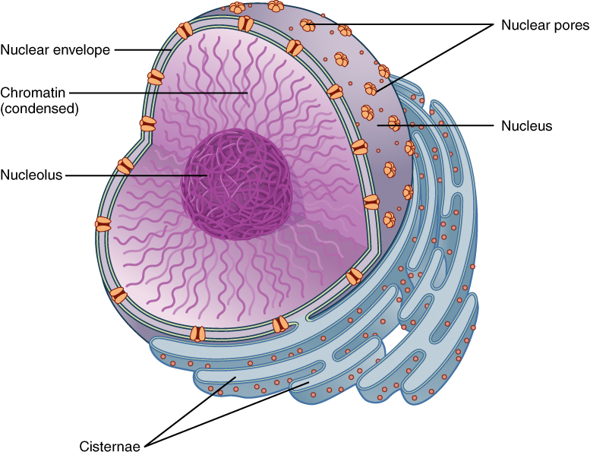
2.Nuclear membrane
The nuclear membrane protects the nucleus by forming a boundary between the nucleus and other cell organelles.

Slide 12
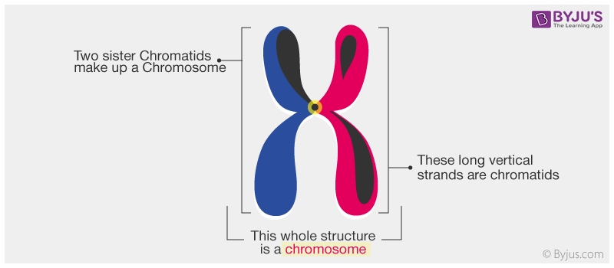
3.Chromosomes
Chromosomes play a crucial role in determining the sex of an individual. Each human cells contain 23 pairs of chromosomes.

Slide 13
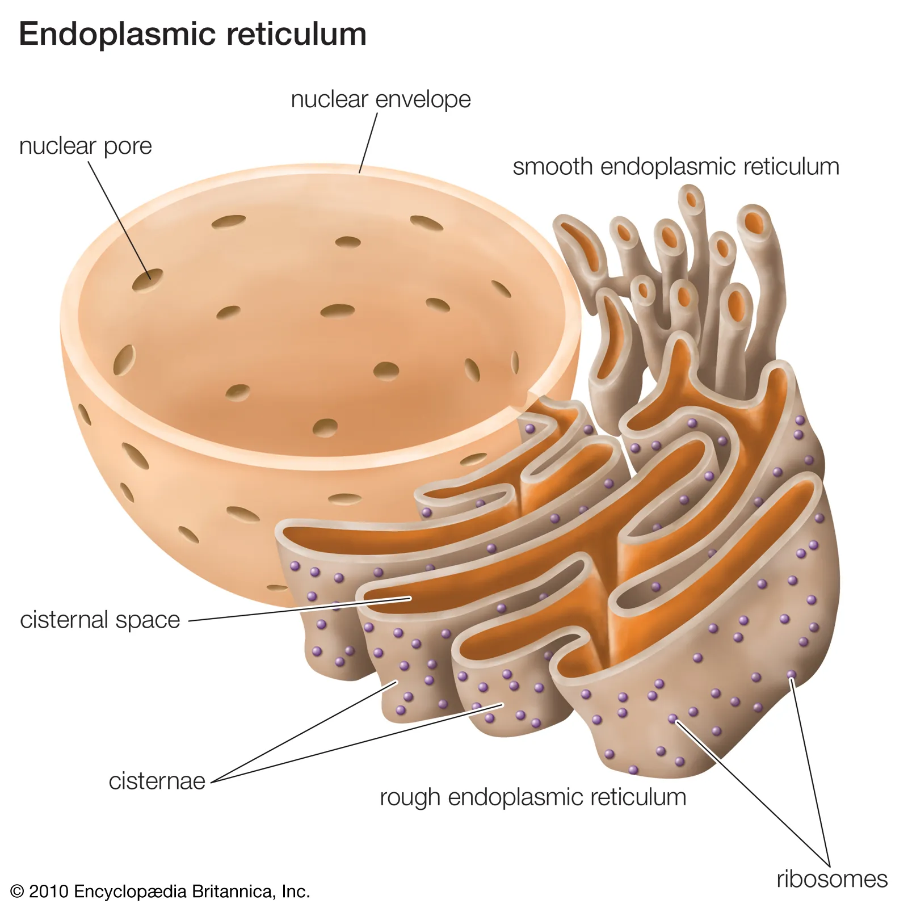
.Endoplasmic reticulum
The endoplasmic reticulum is involved in the transportation of substances throughout the cell. It plays a primary role in the metabolism of carbohydrates, synthesis of lipids, steroids and proteins.

Slide 14
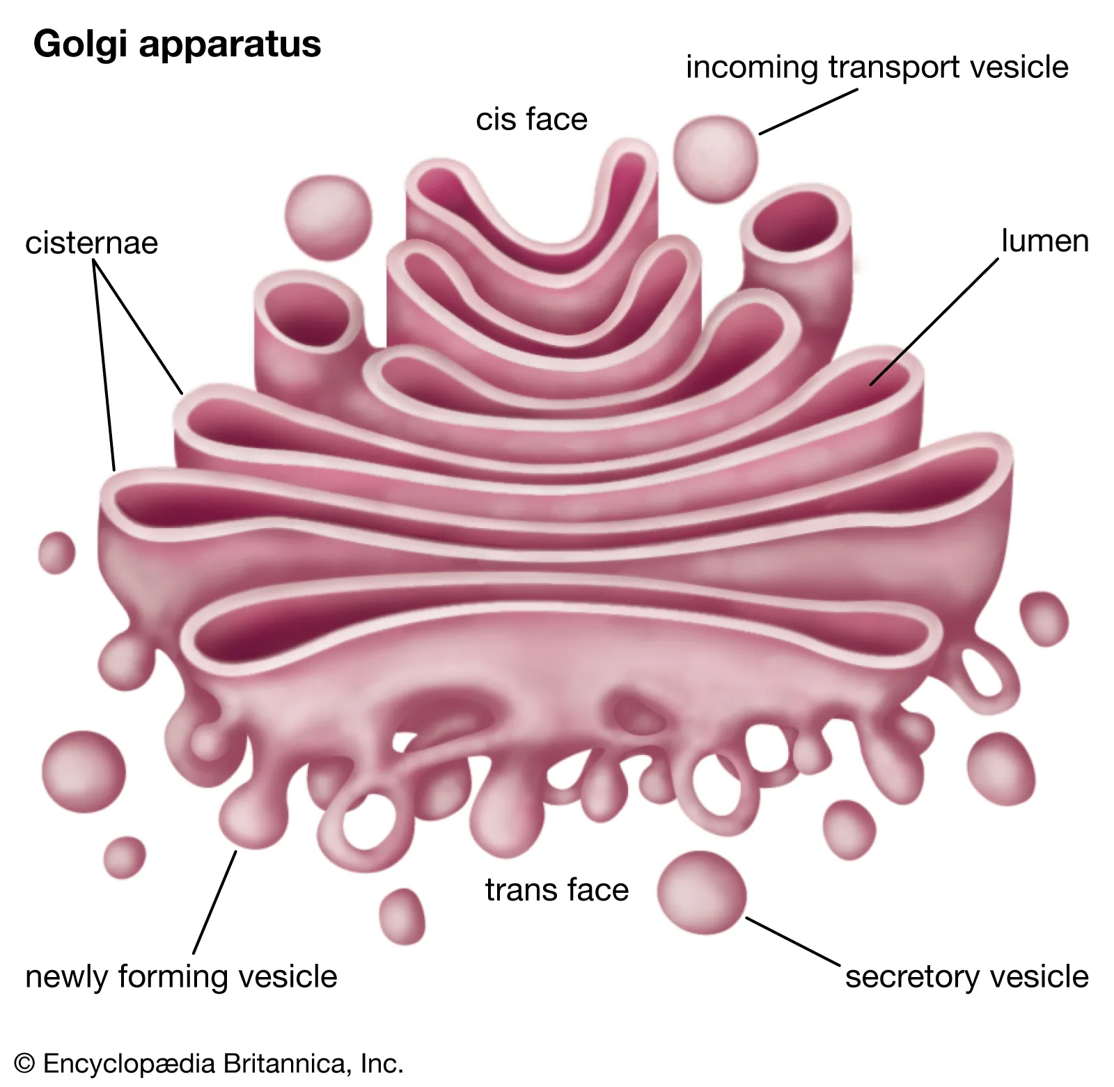
.Golgi Bodies
Golgi bodies are called the cell’s post office as it is involved in the transportation of materials within the cell

Slide 15
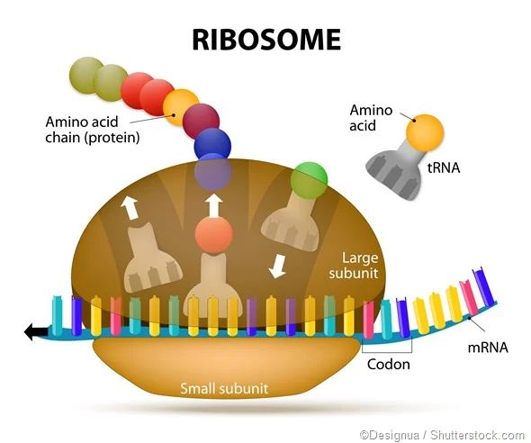
Ribosome
Ribosomes are the protein synthesisers of the cell.

Slide 16
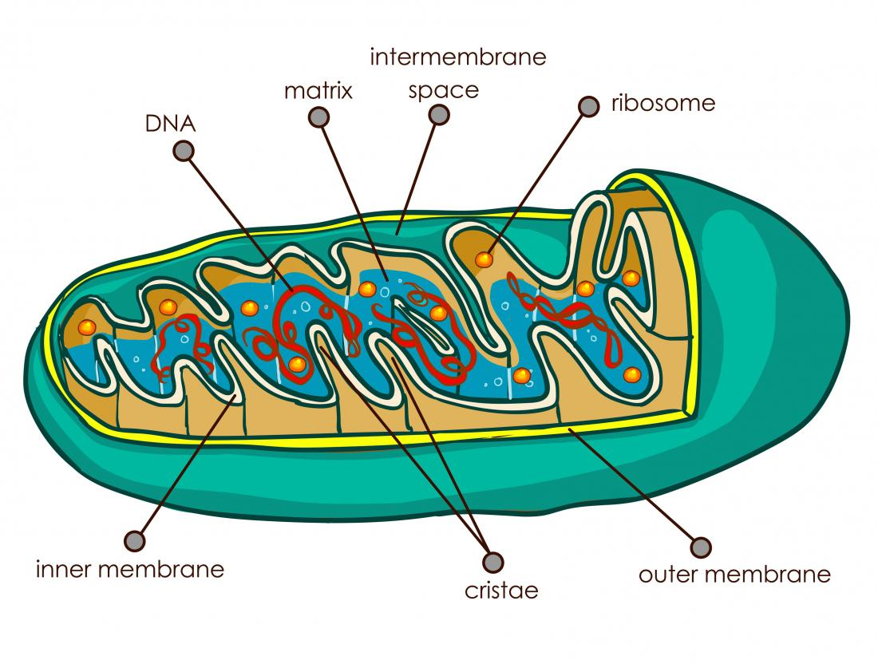
Mitochondria
The mitochondrion is called “the powerhouse of the cell.” It is called so because it produces ATP – the cell’s energy currency.

Slide 17
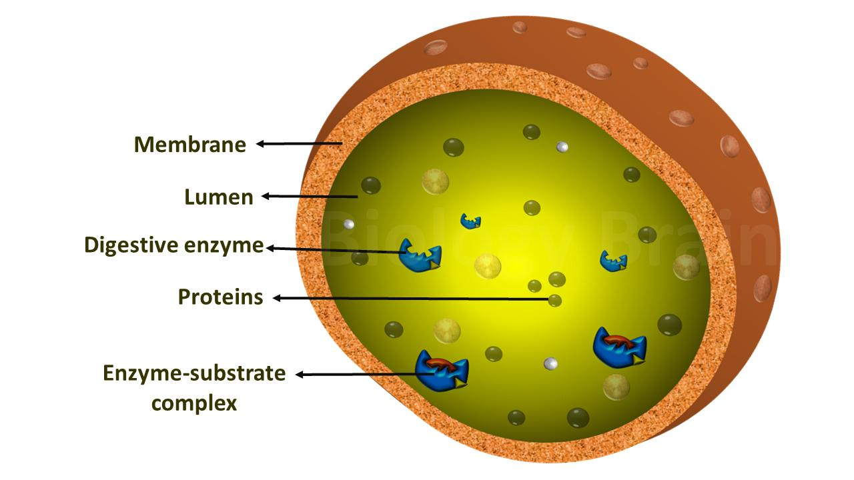
Lysosomes
Lysosomes protect the cell by engulfing the foreign bodies entering the cell and help in cell renewal. Therefore, they are known as the cell’s suicide bags.

Slide 18
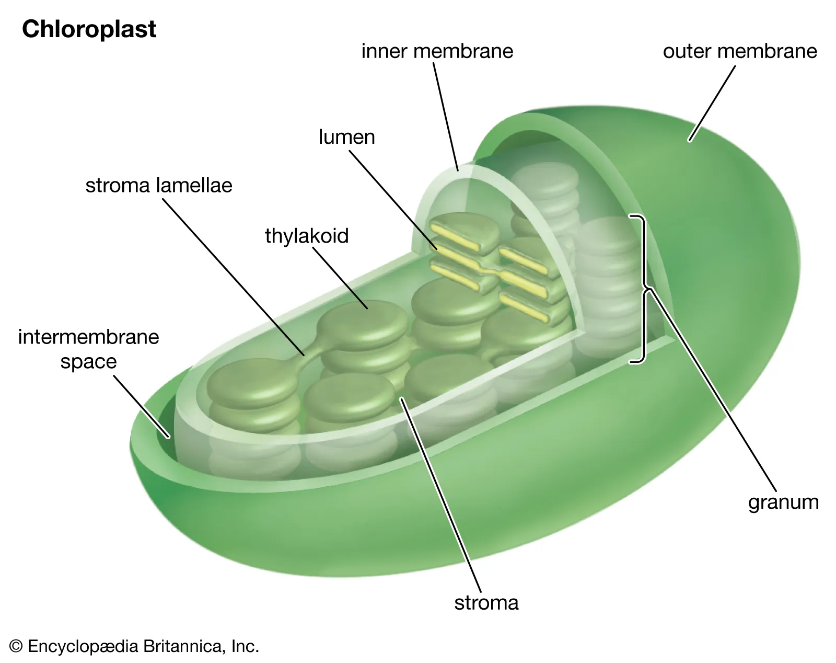
Chloroplast
Chloroplasts are the primary organelles for photosynthesis. It contains the pigment called chlorophyll

Slide 19
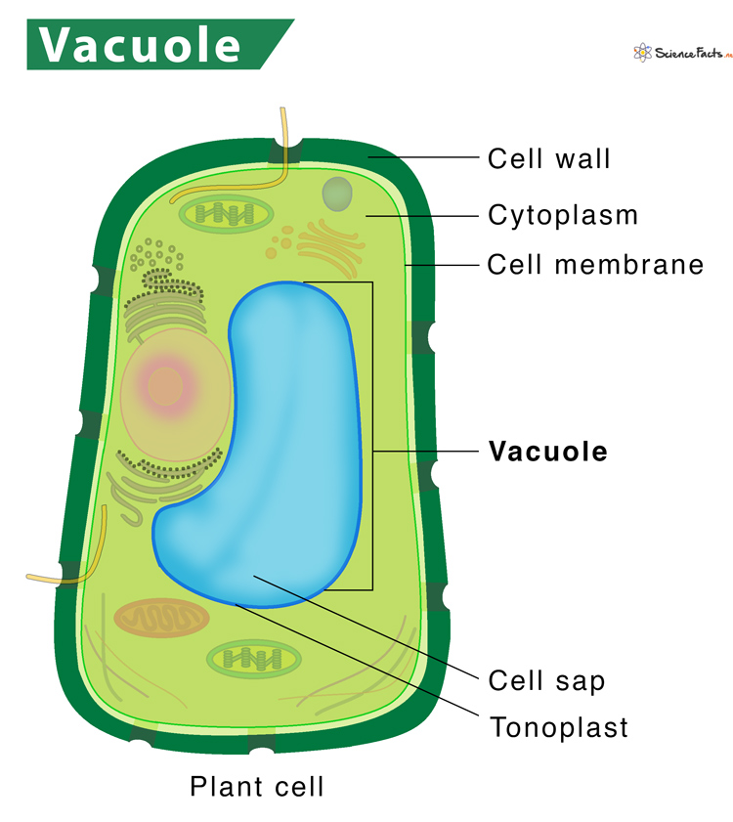
Vacuoles
Vacuoles store food, water, and other waste materials …

Slide 20
FUNCTIONS OF A CELL
A cell performs major functions essential for the growth and development of an organism. Important functions of cell are as follows:
Provides Support and Structure
All the organisms are made up of cells. They form the structural basis of all the organisms. The cell wall and the cell membrane are the main components that function to provide support and structure to the organism. For eg., the skin is made up of a large number of cells. Xylem present in the vascular plants is made of cells that provide structural support to the plants.
Facilitate Growth Mitosis
In the process of mitosis, the parent cell divides into the daughter cells. Thus, the cells multiply and facilitate the growth in an organism.
Allows Transport of Substances
Various nutrients are imported by the cells to carry out various chemical processes going on inside the cells. The waste produced by the chemical processes is eliminated from the cells by active and passive transport. Small molecules such as oxygen, carbon dioxide, and ethanol diffuse across the cell membrane along the concentration gradient. This is known as passive transport. The larger molecules diffuse across the cell membrane through active transport where the cells require a lot of energy to transport the substances.

Slide 21
Energy Production
Cells require energy to carry out various chemical processes. This energy is produced by the cells through a process called photosynthesis in plants and respiration in animals
Aids in Reproduction
A cell aids in reproduction through the processes called mitosis and meiosis. Mitosis is termed as the asexual reproduction where the parent cell divides to form daughter cells. Meiosis causes the daughter cells to be genetically different from the parent cells.
DONE BY : MAHIN GHOSH P.B
SREEJITH . S
FIRST BSc FORENSIC SCIENCE

